Slide 1
UPPER SIXTH ARTS
GEOGRAPHY
Lesson 12
Trade Associations (Trade Blocs)
Notes:
Good morning, class, and welcome to our geography lesson. I am your geography teacher, Mr Kamdem. Today we are starting Lesson 12: Trade Associations (Trade Blocs).

Slide 2
CLASS INFO
Class, Chapter and Duration
Class | Upper Sixth Arts
Chapter | Module 7: Understanding and managing contemporary environmental and development issues
Duration | 2 periods (2 × 50 minutes)
Notes:
This lesson is for Upper Sixth Arts. It belongs to Module 7: Understanding and managing contemporary environmental and development issues. We shall need 2 periods to cover it.

Slide 3
IDENTIFICATION
Lesson Identification
Topic | Current Development Issues
Sub-topic | Trade and Cooperation
Lesson | Lesson 12: Trade Associations (Trade Blocs)
Notions / Concepts | Trade bloc, free trade area, customs union, common market, economic union, CEMAC, ECOWAS, AfCFTA.
Syllabus focus | Meaning and categories; examples from various continents and purposes; CEMAC and ECOWAS (creation, membership, objectives, internal and external trade).
Competence | Learners are able to classify trade blocs and explain the role of CEMAC and ECOWAS.
Notes:
Our topic is Current Development Issues, and the sub-topic is Trade and Cooperation. The key notions we shall use today are: trade bloc, free trade area, customs union, common market, economic union, CEMAC, ECOWAS, AfCFTA. At the end, you should be able to do this: learners are able to classify trade blocs and explain the role of CEMAC and ECOWAS.

Slide 4

HOMEWORK CORRECTION
Correction of the Homework
Question (Lesson 11: International Trade):
Find the main trading partners of Cameroon and draw a flow map.
Notes:
Before we start the new lesson, let us correct the homework I gave you at the end of Lesson 11: International Trade. The question was: Find the main trading partners of Cameroon and draw a flow map. Take out your exercise books.

Slide 5
HOMEWORK CORRECTION
Correction: Possible Answer
Main partners: China, France, the Netherlands, Italy, Nigeria, India and Chad. On the map, draw arrows from Cameroon to each partner, with widths proportional to the value of trade.
Notes:
Here is a good answer. Main partners: China, France, the Netherlands, Italy, Nigeria, India and Chad. On the map, draw arrows from Cameroon to each partner, with widths proportional to the value of trade. Compare it with your own answer and correct your work in red.

Slide 6
LESSON PLAN
Lesson Plan
Correction of the homework
Objectives and recall
Real-life situation and action to take
Learning activities
Board summary
Evaluation, remediation and homework
Notes:
Here is the plan of our lesson today. First, we shall correct the homework. Then we shall look at the objectives and recall what you already know. After that, we shall study a situation from real life and the action to take, and do the learning activities. Finally, we shall copy the board summary, do the evaluation and the remediation, and I will give you the homework.

Slide 7
OBJECTIVES
Objectives
By the end of this lesson, you should be able to:
Define a trade bloc and its categories.
Give examples from different continents.
Describe CEMAC and ECOWAS.
Notes:
By the end of this lesson, you should be able to do three things. Number 1: define a trade bloc and its categories. Number 2: give examples from different continents. Number 3: describe CEMAC and ECOWAS.

Slide 8
PREVIOUS KNOWLEDGE
Previous Knowledge
Cameroon uses the CFA franc.
Goods cross borders to Chad and Gabon.
Notes:
Let us first remember what you already know. Cameroon uses the CFA franc. Goods cross borders to Chad and Gabon. Keep this in mind, because we shall build on it today.

Slide 9
REAL-LIFE SITUATION
Situation in Real Life
A trader from Kousseri takes goods to N'Djamena in Chad without paying high taxes, because both countries belong to CEMAC. But at the Nigerian border, rules are different.
Notes:
Listen carefully to this situation from real life. A trader from Kousseri takes goods to N'Djamena in Chad without paying high taxes, because both countries belong to CEMAC. But at the Nigerian border, rules are different. Think about it, because I am going to ask you some questions.

Slide 10
REAL-LIFE SITUATION
Situation: Question 1
What is the problem in the situation?
Notes:
Question 1: What is the problem in the situation? Think for a moment, then raise your hand to answer.

Slide 11
REAL-LIFE SITUATION
Answer
Trade rules differ between blocs.
Notes:
Good. Trade rules differ between blocs.

Slide 12
REAL-LIFE SITUATION
Situation: Question 2
Which bloc do Cameroon and Chad belong to?
Notes:
Question 2: Which bloc do Cameroon and Chad belong to? Think for a moment, then raise your hand to answer.

Slide 13
REAL-LIFE SITUATION
Answer
CEMAC.
Notes:
Good. CEMAC.

Slide 14
REAL-LIFE SITUATION
Situation: Question 3
Which bloc does Nigeria belong to?
Notes:
Question 3: Which bloc does Nigeria belong to? Think for a moment, then raise your hand to answer.

Slide 15
REAL-LIFE SITUATION
Possible Answer
ECOWAS.
Notes:
Good. ECOWAS.

Slide 16
ACTION TO TAKE
Action to Take
Support trade and cooperation between African countries.
Notes:
From this situation, the action we are working towards in this lesson is the following: support trade and cooperation between African countries.

Slide 17
JUSTIFICATION
Justification of the Lesson
This lesson helps us to understand how countries cooperate to trade.
Notes:
Why is this lesson important for you? This lesson helps us to understand how countries cooperate to trade.

Slide 18
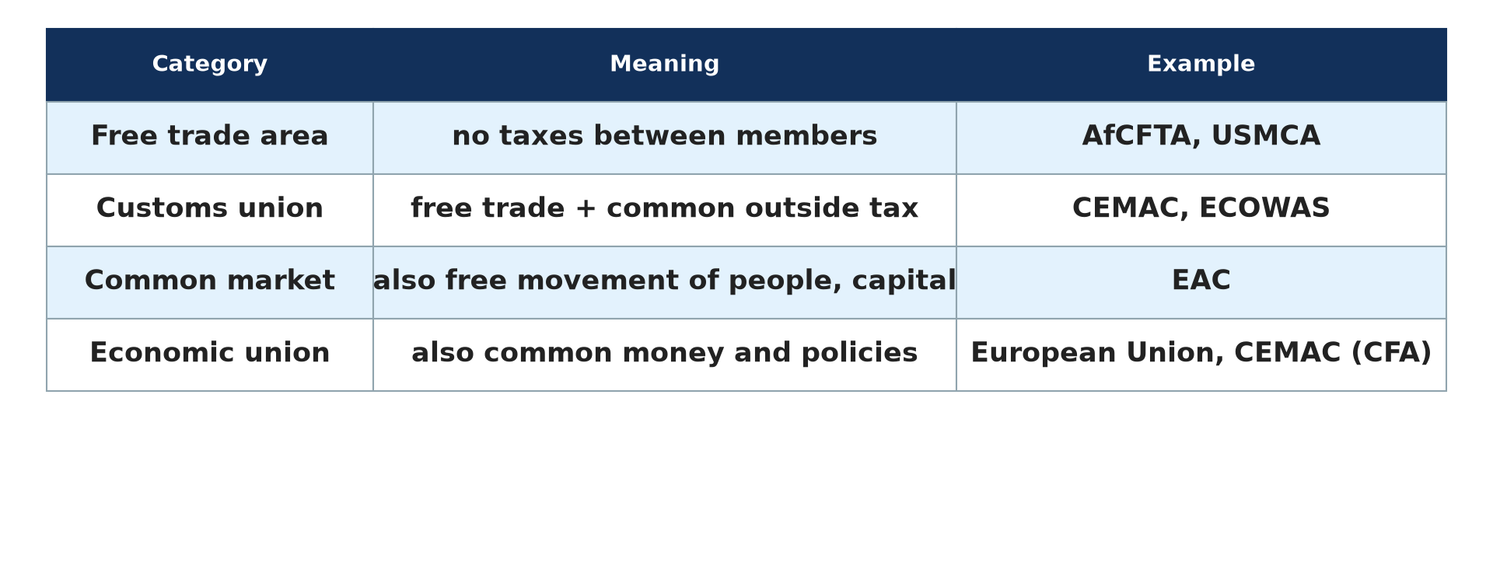
1. CATEGORIES OF TRADE BLOCS
Activity 1
Categories of trade blocs.
Notes:
Activity 1. Look carefully at this diagram: categories of trade blocs. Observe every detail before I ask the question.

Slide 19
1. CATEGORIES OF TRADE BLOCS
Activity 1: Question
Distinguish a free trade area and a customs union.
Notes:
Here is the question for Activity 1: Distinguish a free trade area and a customs union. Take one minute to think and write your answer in your rough notebook.

Slide 20
1. CATEGORIES OF TRADE BLOCS
Activity 1: Answer
Free trade area: no taxes between members. Customs union: also a common tax on outside goods.
Notes:
Let us check the answer together. Free trade area: no taxes between members. Customs union: also a common tax on outside goods.

Slide 21

2. EXAMPLES
Activity 2
Goods traded between countries.
Notes:
Activity 2. Look carefully at this picture: goods traded between countries. Observe every detail before I ask the question.

Slide 22
2. EXAMPLES
Activity 2: Question
Give one trade bloc from Europe, America and Africa.
Notes:
Here is the question for Activity 2: Give one trade bloc from Europe, America and Africa. Take one minute to think and write your answer in your rough notebook.

Slide 23
2. EXAMPLES
Activity 2: Answer
European Union, USMCA (formerly NAFTA) and AfCFTA.
Notes:
Let us check the answer together. European Union, USMCA (formerly NAFTA) and AfCFTA.

Slide 24
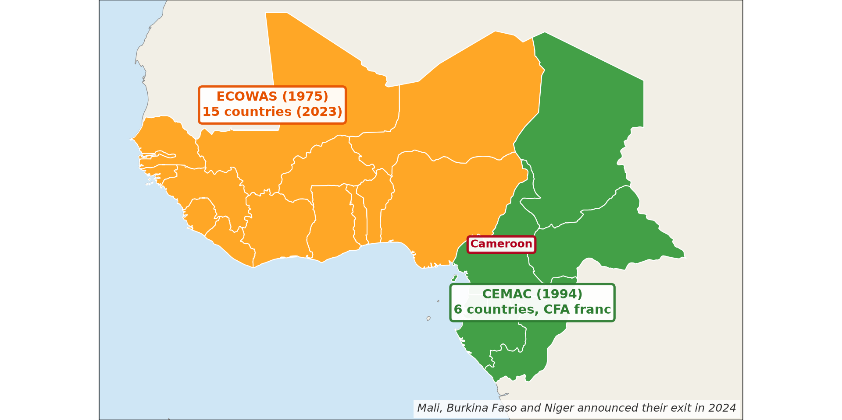
3. CEMAC AND ECOWAS
Activity 3
CEMAC and ECOWAS.
Notes:
Activity 3. Look carefully at this diagram: cEMAC and ECOWAS. Observe every detail before I ask the question.

Slide 25
3. CEMAC AND ECOWAS
Activity 3: Question
Name the six members of CEMAC.
Notes:
Here is the question for Activity 3: Name the six members of CEMAC. Take one minute to think and write your answer in your rough notebook.

Slide 26
3. CEMAC AND ECOWAS
Activity 3: Answer
Cameroon, Chad, CAR, Congo, Gabon and Equatorial Guinea.
Notes:
Let us check the answer together. Cameroon, Chad, CAR, Congo, Gabon and Equatorial Guinea.

Slide 27

3. OBJECTIVES
Activity 4
A market.
Notes:
Activity 4. Look carefully at this picture: a market. Observe every detail before I ask the question.

Slide 28
3. OBJECTIVES
Activity 4: Question
Give two objectives of CEMAC.
Notes:
Here is the question for Activity 4: Give two objectives of CEMAC. Take one minute to think and write your answer in your rough notebook.

Slide 29
3. OBJECTIVES
Activity 4: Answer
Free movement of goods and people, and a common currency and policies.
Notes:
Let us check the answer together. Free movement of goods and people, and a common currency and policies.

Slide 30
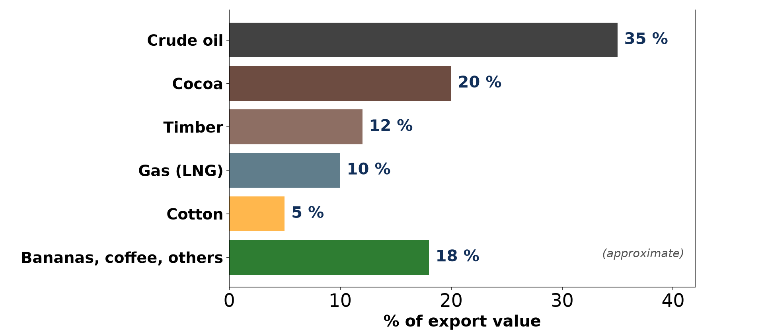
3. TRADE WITHIN CEMAC
Activity 5
Exports of Cameroon (approximate).
Notes:
Activity 5. Look carefully at this diagram: exports of Cameroon (approximate). Observe every detail before I ask the question.

Slide 31
3. TRADE WITHIN CEMAC
Activity 5: Question
Why is trade inside CEMAC small?
Notes:
Here is the question for Activity 5: Why is trade inside CEMAC small? Take one minute to think and write your answer in your rough notebook.

Slide 32
3. TRADE WITHIN CEMAC
Activity 5: Answer
Members produce similar raw materials and roads are poor.
Notes:
Let us check the answer together. Members produce similar raw materials and roads are poor.

Slide 33
BOARD SUMMARY
Board Summary
Topic: Current Development Issues
Sub-topic: Trade and Cooperation
Lesson 12: Trade Associations (Trade Blocs)
Notes:
Now we are going to copy the board summary. Write the title and the headings neatly in your notebooks. I will give you enough time for each slide, so do not rush.

Slide 34
BOARD SUMMARY
1. Meaning and Categories of Trade Blocs
Trade blocs can be defined and classified as follows:
Trade bloc: It is a group of countries that reduce trade barriers between them. It increases trade and gives members more power in world trade.
Notes:
Let us copy Meaning and Categories of Trade Blocs. Trade blocs can be defined and classified as follows. On this slide we have Trade bloc. Write each point on a new line, with the key term first, and explain it in your own words when we revise. When you finish, we go to the next slide.

Slide 35
BOARD SUMMARY
1. Meaning and Categories of Trade Blocs (continued)
Free trade area and customs union: In a free trade area members remove tariffs between them. A customs union also sets a common external tariff.
Notes:
We continue with Meaning and Categories of Trade Blocs. On this slide we have Free trade area and customs union. Write each point on a new line, with the key term first, and explain it in your own words when we revise. When you finish, we go to the next slide.

Slide 36
BOARD SUMMARY
1. Meaning and Categories of Trade Blocs (continued)
Common market and economic union: A common market adds the free movement of people and capital. An economic union also shares economic policies and sometimes a currency.
Notes:
We continue with Meaning and Categories of Trade Blocs. On this slide we have Common market and economic union. Write each point on a new line, with the key term first, and explain it in your own words when we revise.

Slide 37
BOARD SUMMARY
1. Meaning and Categories of Trade Blocs
Illustration: categories of trade blocs
Notes:
Now draw this illustration in your notebook: categories of trade blocs. Give it a title and label it clearly.

Slide 38
BOARD SUMMARY
2. Examples of Trade Blocs
Trade blocs exist on all continents:
Europe and America: The European Union is the most integrated bloc, with the euro. The USMCA (formerly NAFTA) and MERCOSUR group American countries.
Notes:
Let us copy Examples of Trade Blocs. Trade blocs exist on all continents. On this slide we have Europe and America. Write each point on a new line, with the key term first, and explain it in your own words when we revise. When you finish, we go to the next slide.

Slide 39
BOARD SUMMARY
2. Examples of Trade Blocs (continued)
Africa and Asia: CEMAC, ECOWAS, SADC and the AfCFTA promote African trade. ASEAN groups the countries of South-East Asia.
Notes:
We continue with Examples of Trade Blocs. On this slide we have Africa and Asia. Write each point on a new line, with the key term first, and explain it in your own words when we revise.

Slide 40
BOARD SUMMARY
3. CEMAC and ECOWAS
The two blocs near Cameroon are described as follows:
CEMAC: It was created in 1994 by Cameroon, Gabon, Congo, Chad, the CAR and Equatorial Guinea, and it uses the CFA franc. It aims at free movement of goods and people and a common market.
Notes:
Let us copy CEMAC and ECOWAS. The two blocs near Cameroon are described as follows. On this slide we have CEMAC. Write each point on a new line, with the key term first, and explain it in your own words when we revise. When you finish, we go to the next slide.

Slide 41
BOARD SUMMARY
3. CEMAC and ECOWAS (continued)
ECOWAS: It was created in 1975 and groups West African states, such as Nigeria and Ghana. It aims at a common market and free movement of people.
Notes:
We continue with CEMAC and ECOWAS. On this slide we have ECOWAS. Write each point on a new line, with the key term first, and explain it in your own words when we revise. When you finish, we go to the next slide.

Slide 42
BOARD SUMMARY
3. CEMAC and ECOWAS (continued)
Internal and external trade: Trade inside CEMAC is small because members produce similar raw materials and roads are poor. Most of their trade is with Europe and China.
Notes:
We continue with CEMAC and ECOWAS. On this slide we have Internal and external trade. Write each point on a new line, with the key term first, and explain it in your own words when we revise.

Slide 43
BOARD SUMMARY
3. CEMAC and ECOWAS
Illustration: CEMAC and ECOWAS
Notes:
Now draw this illustration in your notebook: cEMAC and ECOWAS. Give it a title and label it clearly.

Slide 44
FORMATIVE EVALUATION
Evaluation 1
Give four categories of trade blocs.
Notes:
Now let us check what you have understood. Question 1: Give four categories of trade blocs. Answer in your exercise book.

Slide 45
FORMATIVE EVALUATION
Expected Answer
Free trade area, customs union, common market, economic union.
Notes:
The expected answer is: free trade area, customs union, common market, economic union. If you got it right, well done.

Slide 46
FORMATIVE EVALUATION
Evaluation 2
Compare CEMAC and ECOWAS (date, members).
Notes:
Now let us check what you have understood. Question 2: Compare CEMAC and ECOWAS (date, members). Answer in your exercise book.

Slide 47
FORMATIVE EVALUATION
Expected Answer
CEMAC: 1994, 6 members. ECOWAS: 1975, 15 members.
Notes:
The expected answer is: cEMAC: 1994, 6 members. ECOWAS: 1975, 15 members. If you got it right, well done.

Slide 48
REMEDIATION
Remediation
Fill in the blanks:
CEMAC was created in ______.
ECOWAS was created in ______.
The African free trade area is ______.
Notes:
For those who need more practice, fill in the blanks in your exercise book. The answers are: number 1, 1994; number 2, 1975; number 3, AfCFTA.

Slide 49
HOMEWORK
Homework
Find out which goods Cameroon sells to Chad and Gabon.
Notes:
For your homework: Find out which goods Cameroon sells to Chad and Gabon. We shall correct it at the beginning of our next lesson.

Slide 50
NEXT LESSON
Next Lesson
Our next lesson will be on:
Lesson 13: Recent Developments in Global Trade
Notes:
Our next lesson will be on Lesson 13: Recent Developments in Global Trade. Thank you for your attention, and see you next time.

Slide 51
BILINGUAL GAME
Bilingual Game (Jeu Bilingue)
English | Français
Trade bloc | Le bloc commercial
Customs union | L'union douanière
Border | La frontière
Member | Le membre
Currency | La monnaie
Free movement | La libre circulation
Notes:
Let us play the bilingual game. I say a word in English, and you give me the French word. Then we do the reverse.

Slide 52
LOGBOOK
Official Logbook (1/2)
Module / Topic | Current Development Issues
Lesson Title | Lesson 12: Trade Associations (Trade Blocs)
Expected Learning Outcomes | Define a trade bloc and its categories. Give examples from different continents. Describe CEMAC and ECOWAS.
Competence | Learners are able to classify trade blocs and explain the role of CEMAC and ECOWAS.
Notes:
I record this information in the official logbook of the class after the lesson.

Slide 53
LOGBOOK
Official Logbook (2/2)
Matter Taught | Meaning and Categories of Trade Blocs; Examples of Trade Blocs; CEMAC and ECOWAS.
Evaluation | Formative evaluation and remediation exercise.
Homework | Find out which goods Cameroon sells to Chad and Gabon.
Enrolment / Present / Absent | ____ / ____ / ____
Achievement | To be completed after the lesson.
Notes:
I complete the second page of the logbook: the matter taught, the evaluation, the homework and the attendance.

Slide 54
TEACHER'S NOTE
Teacher's Note
Timing: Homework correction, plan, objectives 8 min | Recall, situation, action 10 min | 5 activities 30 min | Board summary (copying) 30 min | Evaluation, remediation 10 min | Homework, next lesson 5 min | Logbook 7 min
Without the projector (Activity 1): read the table.
Without the projector (Activity 2): list blocs.
Without the projector (Activity 3): read the map.
Without the projector (Activity 4): discuss CEMAC.
Without the projector (Activity 5): discuss the problem.
Notes:
This slide is for me, the teacher: it gives the timing of the lesson and what to do if the projector is not available.

Slide 55
REFERENCES
References
National Geography Syllabus, MINESEC/IGE/IP-SS, 2019 — Module 7 (Environment and Development).
Photo, Activity 2: “Container Ships @ Port of Oakland” by jdnx, CC BY 2.0, via Flickr (https://www.flickr.com/photos/21442511@N08/3464243881)
Photo, Activity 4: “Sandga Market in Douala, Cameroon” by The Advocacy Project, CC BY-NC-SA 2.0, via Flickr (https://www.flickr.com/photos/42487558@N00/3636438732)
Diagrams and animations: drawn for this lesson (Geography Department).
Notes:
These are the references and picture credits used to prepare this lesson.

